Slide 1
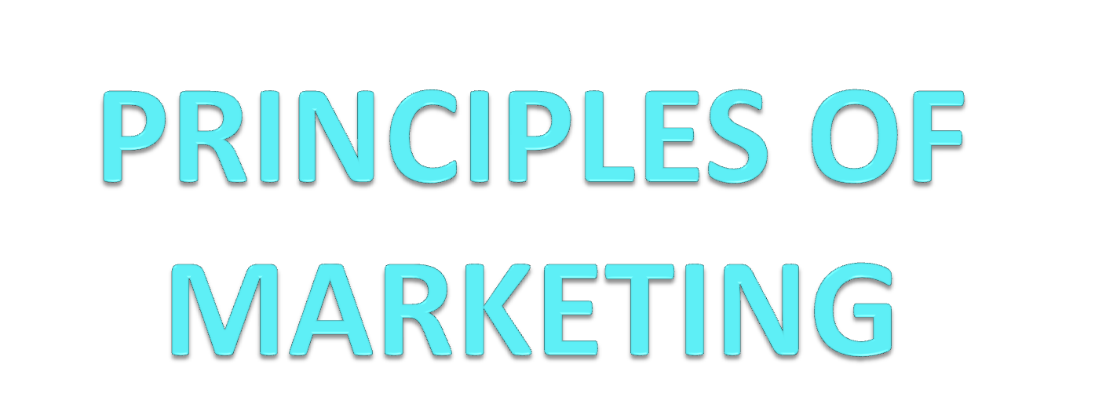
Prof. S N Singh

Slide 2
PURPOSE OF MODULE
Principles of Marketing focuses on helping students to understand the following:
This course examines the fundamental concepts in marketing.
The course focuses on tools and methods used to examine marketing environments, understand consumer and organizational buying behavior, segment markets and position products, develop new products development, manage existing products and promote price and place products.

Slide 3
LEARNING OUTCOMES
By the end of the module students should be able to;
At the end of this course, the students are expected;
To introduce the marketing concept and their applications to organizations
To understand the concept of evolution of marketing.
To classify the marketing functions
To understand the concept of product planning and development
To identify the major channels of distribution
To understand the concept of advertising, sales promotion and personal selling
To identify the factors affecting product pricing decisions
To understand the concept of consumer and organizational buying behavior.

Slide 4
Introduction of Marketing
Marketing Definition-American Marketing Association
Marketing is the activity, set of institutions, and processes for creating, communicating, delivering, and exchanging offerings that have value for customers, clients, partners, and society at large
Philip Kotler defines marketing
Marketing is the social process by which individuals and groups obtain what they need and want through creating and exchanging products and value with others
The Chartered Institute of Marketing
The management process responsible for identifying, anticipating and satisfying customer requirements profitability

Slide 5
Philosophy of Marketing Management
Important Concept of Marketing Management Philosophy:
The marketing concept is the strategy that firms implement to satisfy customers needs, increase sales, maximize profit and beat the competition. There are five marketing concepts that organizations adopt and execute
Marketing is a department of management that tries to design strategies that will build profitable relationships with target consumers. But what philosophy is the best for a company in setting marketing strategies?
There are five alternative concepts under which organizations design and carry out their marketing strategies.

Slide 6
Contt.
Marketing Concepts:
Production Concept,
Product Concept,
Selling Concept,
Marketing Concept,
Societal Marketing Concept

Slide 7
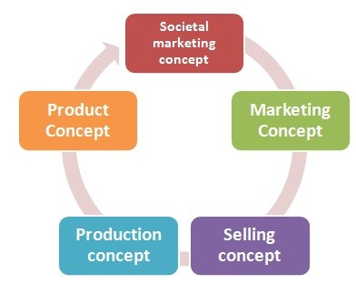
Contt.

Slide 8
Contt.
Product Concept:
The product concept holds that the consumers will favor products that offer the most in quality, performance and innovative features.
Marketing strategies are focused on making continuous product improvements.
Product quality and improvement are important parts of marketing strategies, sometimes the only part. Targeting only on the company’s products could also lead to marketing myopia.

Slide 9
Contt.
Production Concept:
The idea of production concept – “Consumers will favor products that are available and highly affordable”. This concept is one of the oldest Marketing management orientations that guide sellers.
Companies adopting this orientation run a major risk of focusing too narrowly on their own operations and losing sight of the real objective.
Most times; the production concept can lead to marketing myopia. Management focuses on improving production and distribution efficiency

Slide 10
Contt.
Selling Concept:
The selling concept holds the idea- “consumers will not buy enough of the firm’s products unless it undertakes a large-scale selling and promotion effort”.
Here the management focuses on creating sales transactions rather than on building long-term, profitable customer relationships.
The aim is to sell what the company makes rather than making what the market wants. Such aggressive selling program carries very high risks.

Slide 11
Contt.
Marketing Concept:
The marketing concept holds- “achieving organizational goals depends on knowing the needs and wants of target markets and delivering the desired satisfactions better than competitors do”.
Here marketing management takes a “customer first” approach.
Under the marketing concept, customer focus and value are the routes to achieve sales and profits.
The marketing concept is a customer-centered

Slide 12
Contt.
Societal marketing concept :
The societal marketing concept holds “marketing strategy should deliver value to customers in a way that maintains or improves both the consumer’s and society’s well-being”.
It calls for sustainable marketing, socially and environmentally responsible marketing that meets the present needs of consumers and businesses while also preserving or enhancing the ability of future generations to meet their needs.
The Societal Marketing Concept puts the Human welfare on top before profits and satisfying the wants.

Slide 13
Benefits of Marketing
These are fallowing benefits of Marketing
Increases awareness – Most of the time we see an advertisement, or get a recommendation, but we don’t always buy the product or use the services straight away. By raising awareness through marketing, you’ll build an audience of potential customers who know who you are, know what you can offer, and know exactly where to find you when they are ready to purchase your products or services.
Increases Sales – When people know your business exists, they’re much more likely to become your customers. If your marketing campaigns are doing their job properly, you’ll start to see an increase in sales shortly after you get started.

Slide 14
Contt.
Creates trust – People want to buy from a business that has a trustworthy reputation. They want to know that they can trust the business they are buying from. It takes time to build the trust and reputation for your business. Once your business can establish this trust with your clients, it creates customer loyalty
Creating A Brand: The brand is the company’s most valuable asset and the sole responsibility to create a brand lies on the shoulder of the marketing department of the organization. The market is full of similar products and the only thing which makes the company stand out is its brand. Today, Brand is not just a combination of name, symbol, and design, it is the business-consumer relationship

Slide 15
Contt.
Product Development: One of the most important aspects of product development is to search for a perfect market for the product, get consumer insights, and develop a perfect proposition to make it stand out of the rest.
Communication: Competition is everywhere and sometimes it’s only the good communication strategy which makes the brand stands out of the rest.
New communication avenues like internet, smart devices, and social media, have opened the doors to new and more targeted communication strategies which eventually lead to more conversions. In this competitive environment, a product without communication is a dead product. Communication infuses life in it and triggers sales.

Slide 16
Contt.
Building Relationships: A relationship is built on trust, understanding, and pride. Marketing plays a very significant role in building a relationship between the customers and the organization.
The relationship, once built, makes the customers more brand loyal and gives them the confidence to repeat sales and buy more products under the same brand
Maintaining the Company’s Reputation
The success and the life-span of the company are positively correlated to the company’s reputation which usually is correlated to the brand equity of the business. A majority of the activities of the marketers are directed towards building the brand equity of the business

Slide 17
Marketing Environment
Definition: The Marketing Environment includes the Internal factors (employees, customers, shareholders, retailers & distributors, etc.) and the External factors political, legal, social, technological, economic that surround the business and influence its marketing operations
Some of these factors are controllable while some are uncontrollable and require business operations to change accordingly. Firms must be well aware of its marketing environment in which it is operating to overcome the negative impact the environment factors are imposing on firm’s marketing activities

Slide 18
Contt.
1-Internal Environment – The Internal Marketing Environment includes all the factors that are within the organization and affects the overall business operations. These factors include labor, inventory, company policy, logistics, budget, capital assets, etc. which are a part of the organization and affects the marketing decision and its relationship with the customers. These factors can be controlled by the firm.
2-Microenvironment- The Micro Marketing Environment includes all those factors that are closely associated with the operations of the business and influences its functioning. The microenvironment factors include customers, employees, suppliers, retailers & distributors, shareholders, Competitors, Government and General Public. These factors are controllable to some extent.

Slide 19
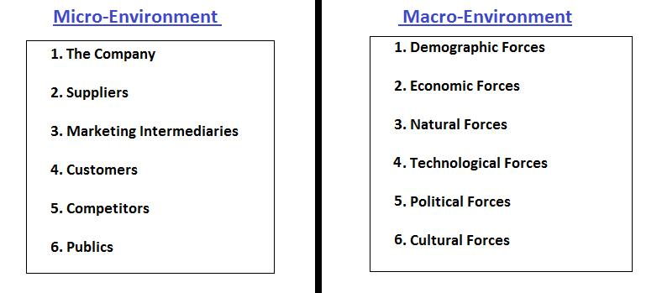


Slide 20
Contt.
Customers– Every business revolves around fulfilling the customer’s needs and wants. Thus, each marketing strategy is customer oriented that focuses on understanding the need of the customers and offering the best product that fulfills their needs.
Employees– Employees are the main component of a business who contributes significantly to its success. The quality of employees depends on the training and motivation sessions given to them.

Slide 21
Contt.
Suppliers– Suppliers are the persons from whom the material is purchased to make a finished good and hence are very important for the organization. It is crucial to identify the suppliers existing in the market and choose the best that fulfills the firm’s requirement.
Retailers & Distributors– The channel partners play an imperative role in determining the success of marketing operations. Being in direct touch with customers they can give suggestions about customer’s desires regarding a product and its services

Slide 22
Contt.
Competitors– Keeping a close watch on competitors enables a company to design its marketing strategy according to the trend prevailing in the market.
Shareholders– Shareholders are the owners of the company, and every firm has an objective of maximizing its shareholder’s wealth. Thus, marketing activities should be undertaken keeping in mind the returns to shareholders.

Slide 23
Contt.
General public– The business has some social responsibility towards the society in which it is operating. Thus, all the marketing activities should be designed that result in increased welfare of the society as a whole.
The Government departments make several policies viz. Pricing policy, credit policy, education policy, housing policy, etc. that do have an influence on the marketing strategies. A company has to keep track on these policies and make the marketing programs accordingly

Slide 24
Contt.
3- Macro Environment-The Macro Marketing Environment includes all those factors that exist outside the organization and can not be controlled. These factors majorly include Social, Economic, Technological Forces, Political and Legal Influences. These are also called as PESTLE framework.

Slide 25
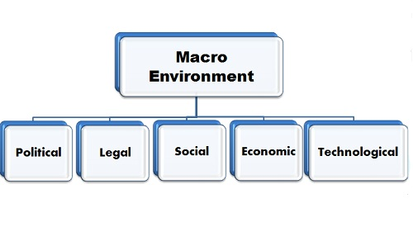

Slide 26
Contt,
Political & Legal Factors– With the change in political parties, several changes are seen in the market in terms of trade, taxes, and duties, codes and practices, market regulations, etc. So the firm has to comply with all these changes and the violation of which could penalize its business operations.
Economic Factors– Every business operates in the economy and is affected by the different phases it is undergoing. In the case of recession, the marketing practices should be different as what are followed during the inflation period.

Slide 27
Contt.
Social Factors– since business operates in a society and has some responsibility towards it must follow the marketing practices that do not harm the sentiments of people. Also, the companies are required to invest in the welfare of general people by constructing public conveniences, parks, sponsoring education, etc.
Technological Factors– As technology is advancing day by day, the firms have to keep themselves updated so that customers needs can be met with more precision.
Therefore, marketing environment plays a crucial role in the operations of a business and must be reviewed on a regular basis to avoid any difficulty.

Slide 28
Functions of Marketing
Functions of Marketing:
Marketing is important to every small business, helping companies increase revenue and profit by meeting customers’ needs effectively.
Although one person or one department is generally responsible for managing the seven functions of marketing,
it’s important for all employees to understand customer needs so they can develop the right products and provide the highest standards of customer service

Slide 29
Contt.
Marketing Information Management
Managing marketing information helps you understand your customers’ needs.
You can gather information by reviewing published market research reports, asking your sales team for feedback or carrying out a survey using a market research firm.
You should also monitor product review sites and social media, such as Facebook and Twitter, where you can find information on consumers’ needs and attitudes toward products.

Slide 30
Contt,
Distribution
Your distribution strategy determines how and where customers can obtain your products. If you market products to a small number of business customers, you may deal with them directly through a sales team.
Product/Service Management
Marketing provides valuable input to product and service development. Information on customers’ needs helps to identify the features to incorporate in new products and product upgrades.
Marketing also identifies opportunities to extend a product range or launch existing products into new sectors.

Slide 31
Contt.
Pricing
Pricing plays an important role in determining market success and profitability. If you market products that have many competitors, you may face strong price competition. In that situation, you must aim to be the lowest-cost supplier so you can set low prices and still remain profitable
Promotion
Promotion makes customers and prospects aware of your products and your company. Using promotional techniques, such as advertising, direct marketing, telemarketing or public relations, you can communicate product benefits and build preference for your company’s products

Slide 32
Contt.
Selling: Marketing and selling are complementary functions. Marketing creates awareness and builds preference for a product, helping company sales representatives or retail sales staff sell more of a product. Marketing also supports sales by generating leads for the sales team to follow up.
Financing: Successful marketing provides a regular flow of revenue to pay for business operations. Marketing programs that strengthen customer loyalty help to secure long-term revenue, while product development programs open new revenue streams. Financing also plays a role in marketing success by offering customers alternative methods of payment, such as loans, extended credit terms

Slide 33
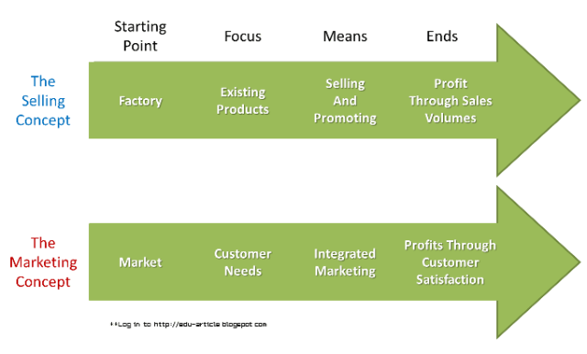
Marketing & Selling

Slide 34
Contt.
Marketing Selling
Long term process Short term process
Profit maximization due to Profit Maximization due to
Satisfied customers selling more product
Customer is king Product is supreme
Main focus on customer Main focus on selling more
Satisfaction volumes of products
Marketing concept starts Selling concept starts at
at understanding the market. the production level.

Slide 35
Marketing Mix
Introduction of Marketing Mix:
Marketing Mix, a term coined by Neil Borden, are the ingredients that combine to capture and promote a brand or product’s unique selling points, those that differentiate it from it’s competitors.
The ideas behind Borden’s model were refined over the years until E. Jerome McCarthy reduced them to 4 elements called “The Four Ps.” This proposed classification has been used by marketing companies, branding agencies and web design companies throughout the world.

Slide 36
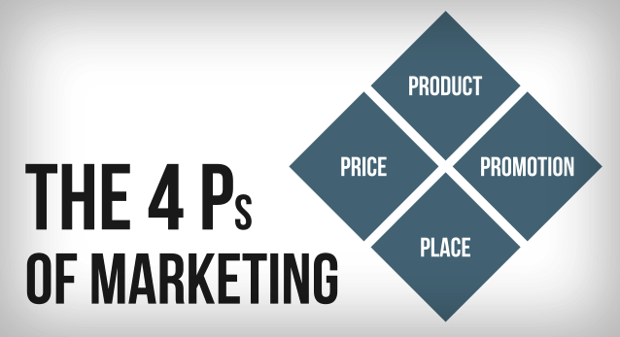
Marketing Mix

Slide 37
Contt.
Product – The first of the Four Ps of marketing is product. A product can be either a tangible good or an intangible service that fulfills a need or want of consumers.
Whether you sell custom pallets and wood products or provide luxury accommodations, it’s imperative that you have a clear grasp of exactly what your product is and what makes it unique before you can successfully market it.

Slide 38
Contt.
Price – Once a concrete understanding of the product offering is established we can start making some pricing decisions.
Price determinations will impact profit margins, supply, demand and marketing strategy. Similar (in concept) products and brands may need to be positioned differently based on varying price points, while price elasticity considerations may influence our next two Ps.

Slide 39
Contt.
Place – Often you will hear marketers saying that marketing is about putting the right product, at the right price, at the right place, at the right time.
It’s critical then, to evaluate what the ideal locations are to convert potential clients into actual clients. Today, even in situations where the actual transaction doesn’t happen on the web, the initial place potential clients are engaged and converted is online

Slide 40
Contt.
Promotion – We’ve got a product and a price now it’s time to promote it. Promotion looks at the many ways marketing agencies disseminate relevant product information to consumers and differentiate a particular product or service.
Promotion includes elements like: advertising, public relations, social media marketing, email marketing, search engine marketing, video marketing and more. Each touch point must be supported by a well positioned brand to truly maximize return on investment.

Slide 41
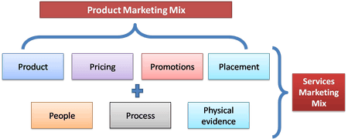
Services Marketing Mix

Slide 42
Contt.
1- Product
The product in service marketing mix is intangible in nature. Like physical products such as a soap or a detergent, service products cannot be measured. Tourism industry or the education industry can be an excellent example. At the same time service products are heterogeneous , perishable and cannot be owned
2-Place: Place in case of services determine where is the service product going to be located. The best place to open up a petrol pump is on the highway or in the city. A place where there is minimum traffic is a wrong location to start a petrol pump.

Slide 43
Contt.
3-Promotion
Promotions have become a critical factor in the service marketing mix. Services are easy to be duplicated and hence it is generally the brand which sets a service apart from its counterpart. You will find a lot of banks and telecom companies promoting themselves rigorously. Thus banks, IT companies, and dotcoms place themselves above the rest by advertising or promotions.
4- Pricing: Pricing in case of services is rather more difficult than in case of products. If you were a restaurant owner, you can price people only for the food you are serving. But then who will pay for the nice ambiance you have built up for your customers? Who will pay for the band you have for music? Thus these elements have to be taken into consideration while costing.

Slide 44
Contt.
5- People
People is one of the elements of service marketing mix. People define a service. If you have an IT company, your software engineers define you. If you have a restaurant, your chef and service staff defines you. If you are into banking , employees in your branch and their behavior towards customers defines you
6- Process
Service process is the way in which a service is delivered to the end customer. Lets take the example of two very good companies – Mcdonalds and Fedex . Both the companies thrive on their quick service and the reason they can do that is their confidence on their processes.

Slide 45
Contt.
7- Physical Evidence:
The last element in the service marketing mix is a very important element. As said before, services are intangible in nature. However, to create a better customer experience tangible elements are also delivered with the service. Take an example of a restaurant which has only chairs and tables and good food, or a restaurant which has ambient lighting, nice music along with good seating arrangement and this also serves good food.

Slide 46
Services Marketing
Definition and Characteristics
The American Marketing Association defines services as - “Activities, benefits and satisfactions which are offered for sale or are provided in connection with the sale of goods
characteristics of a service are:
Intangibility: Services are intangible and do not have a physical existence. Hence services cannot be touched, held, tasted or smelt. This is most defining feature of a service
Heterogeneity/Variability: Given the very nature of services, each service offering is unique and cannot be exactly repeated even by the same service provider

Slide 47
Contt.
Perishability: Services cannot be stored, saved, returned or resold once they have been used. Once rendered to a customer the service is completely consumed and cannot be delivered to another customer. eg: A customer dissatisfied with the services of a barber cannot return the service of the haircut that was rendered to him
Inseparability/Simultaneity of production and consumption: This refers to the fact that services are generated and consumed within the same time frame. Eg: a haircut is delivered to and consumed by a customer simultaneously

Slide 48
Difference Between Goods & Services
Goods Services
Tangible Intangible
Homogenous Heterogeneous
Can be stored Cannot be stored
Transfer of ownership is possible Not possible
A physical commodity A process or activity

Slide 49
4 C’s of Marketing
Four C’s of Marketing Mix:
Now a days, organizations treat their customers like kings. In the current scenario, the four C’s has thus replaced the four P’s of marketing making it a more customer oriented model. Koichi Shimizu in the year 1973 proposed a four C’s classification.
Commodity - (Replaces Products)
Cost - (Replaces Price) involves manufacturing cost, buying cost and selling cost
Channel - The various channels which help the product reach the target market.
Communication - (Replaces Promotion)

Slide 50
Contt.
Robert F. Lauterborn gave a modernized version of the four C’s model in the year 1993. According to him the four C’s of marketing are:
1-Consumer
2-Cost
3-Convenience
4-Communication

Slide 51
Product Life Cycle
Introduction of Product life cycle (PLC)
the theory of a product life cycle was first introduced in the 1950s to explain the expected life cycle of a typical product from design to obsolescence, a period divided into the phases of product introduction, product growth, maturity, and decline. The goal of managing a product's life cycle is to maximize its value and profitability at each stage. Life cycle is primarily associated with marketing This theory was developed by Theodore Levitt.

Slide 52
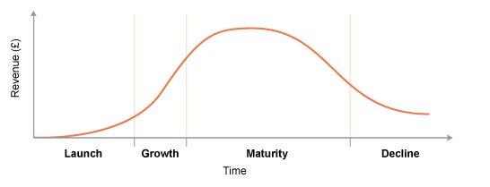
Contt.

Slide 53
Contt.
These are fallowing steps of Product Life Cycle
Introduction
Growth
Maturity
Decline
INTRODUCTION
This is the stage where a product is conceptualized and first brought to market. The goal of any new product introduction is to meet consumers' needs with a quality product at the lowest possible cost in order to return the highest level of profit.

Slide 54
Contt.
GROWTH
The growth phase occurs when a product has survived its introduction and is beginning to be noticed in the marketplace. At this stage, a company can decide if it wants to go for increased market share or increased profitability. This is the boom time for any product.
Production increases, leading to lower unit costs. Sales momentum builds as advertising campaigns target mass media audiences instead of specialized markets (if the product merits this). Competition grows as awareness of the product builds.
Minor changes are made as more feedback is gathered or as new markets are targeted. The goal for any company is to stay in this phase as long as possible.

Slide 55
Contt.
MATURITY
At the maturity stage, sales growth has started to slow and is approaching the point where the inevitable decline will begin.
Defending market share becomes the chief concern, as marketing staffs have to spend more and more on promotion to entice customers to buy the product.
Additionally, more competitors have stepped forward to challenge the product at this stage, some of which may offer a higher-quality version of the product at a lower price.

Slide 56
Contt.
DECLINE
This occurs when the product peaks in the maturity stage and then begins a downward slide in sales. Eventually, revenues will drop to the point where it is no longer economically feasible to continue making the product. Investment is minimized.
The product can simply be discontinued, or it can be sold to another company. A third option that combines those elements is also sometimes seen as viable, but comes to fruition only rarely. Under this scenario, the product is discontinued and stock is allowed to dwindle to zero, but the company sells the rights to supporting the product to another company, which then becomes responsible for servicing and maintaining the product.

Slide 57
New Product Development
Meaning & Introduction of (NPD)
Product planning and development are essential components for businesses that create products and refine them before offering them for sale.
Planning and development represent two distinct phases of the product creation process. Planning requires information gathering from multiple sources, including consumer input and competition information.
The development stage creates a partnership between the marketing and engineering departments to work together to create a final product that meets consumer needs in the most effective way possible

Slide 58
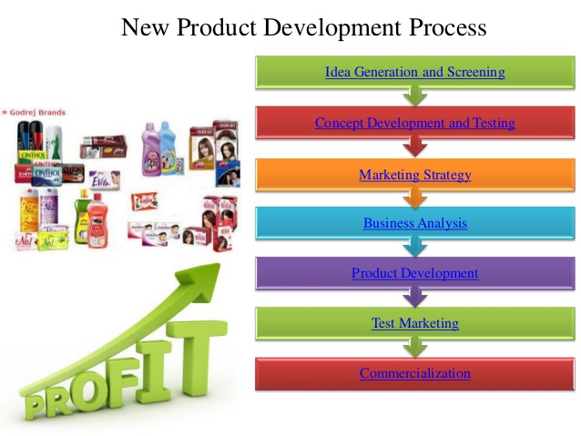
Contt.

Slide 59
Contt.
Generation of New Product Ideas:
The first step in product planning and development is generation of ideas for the development of new/innovative products.
Ideas may come from internal sources like company’s own Research and Development (R&D) department, managers, sales-force personnel etc.; or from external sources like, customers, dealers, competitors, consultants, scientists etc.

Slide 60
Contt.
. Screening of Ideas:
Screening of ideas means a close and detailed examination of ideas, to determine which of the ideas have potential and are capable of making significant contribution to marketing objectives. In fact, generation of ideas is not that significant as the system for screening the generated ideas.
The ideas should be screened properly; as any idea passing this stage would cost the firm in terms of time, money and efforts, at subsequent stages in product planning and development.

Slide 61
Contt.
Product Concept Development:
Those product ideas which clear the screening stage must be developed into a product concept – identifying physical features, benefits, price etc. of the product. At this stage product idea is transformed into a product concept i.e. a product which target market will accept.
Commercial Feasibility:
At this stage, the purpose is to determine whether the proposed product idea is commercially feasible, in terms of demand potential and the costs of production and marketing. Management must also ensure that product concept is compatible with the resources of the organization technological, human and financial.

Slide 62
Contt.
Product Development:
Product development encompasses the technical activities of engineering and design. At this stage, the engineering department converts the product concept into a concert form of product in view of the required size, shape, design, weight, colour etc. of the product concept.
Test Marketing:
A sample of the product is tested in a well-chosen and authentic sales environment; to find out consumers’ reaction. In view of consumers’ reactions, the product may be improved further.

Slide 63
Contt.
.Commercialization:
After the management is satisfied with the results of test marketing, steps are taken to launch a full-fledged programme for the production, promotion and marketing of the product. It is the stage where the new product is born; and it enters it life cycle process

Slide 64
BRANDING
Definition: Branding: A brand is the idea or image of a specific product or service that consumers connect with, by identifying the name, logo, slogan, or design of the company who owns the idea or image “
Branding is a process of creating a unique image or name or logo or symbol or combination of any of these for a specific product in consumer’s mind which differentiates it from competitor’s products.
Branding is a bit complicated and represents the corporate image.

Slide 65

.
Branding: Branding is about selling everything associated with your organization.

Slide 66
Types of Branding
Corporate branding: This type of branding involves using company’s name as product brand name. Here, several products of the company are marketed under the single brand name and such practice is referred as family branding or umbrella branding.
Personal Branding: In this type of branding, individuals and their careers are considered as brands. Athletes, musicians, political leaders etc. promote the products under their name.
Ingredient Branding: This type of branding involves branding a component of certain product in order to project high performance and quality of that particular component.

Slide 67
Contt.
Rebranding: This type of branding involves designing new symbol or logo or sort of, to already existing brand in order to create a differentiation among the customers.
Co-Branding: In this type of branding, two or more brands of different products are promoted at a time. This can give consumer a choice of one-stop shopping of his/her favorite brands.
Cultural Branding: This type of branding involves making promises to workers about improvement in their work environment and relationships with higher management officials.
Examples Like Apple Company means innovative products and best customer service

Slide 68
Contt.
Benefits of a Strong Brand:
A brand is the personality that identifies a product, service or company
A brand is therefore one of the most valuable elements in an advertising the products
A brand which is widely known in the marketplace acquires brand recognition
Proper branding can yield higher product sales, and higher sales of products associated with the brand (or brand association).

Slide 69
Packaging & Labeling
Meaning of Packaging & Labeling in Marketing-
Packaging and labeling do more than protect and identify your company’s products. They play a vital role in developing your image and brand within your target market.
Failing to pay attention to the design of your packaging and labeling can decrease the visibility and attractiveness of your products, which can be devastating for sales
Packaging
. It contains and protects your product. It promotes your product. It helps consumers use your product

Slide 70
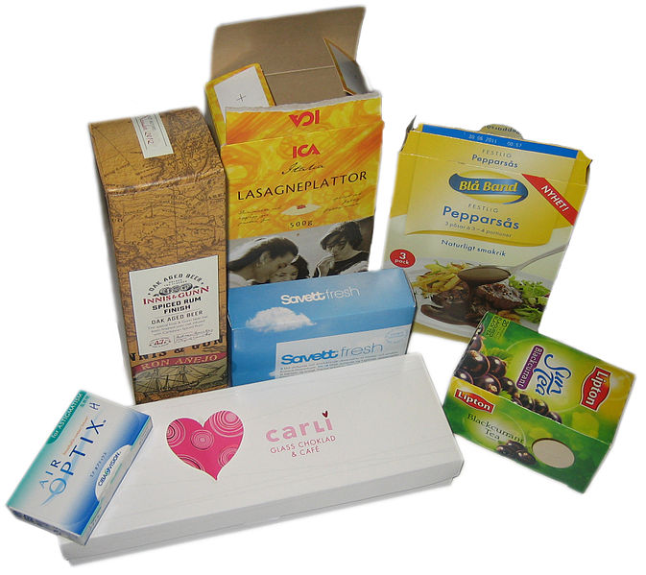
Contt.

Slide 71
Contt.
Packaging has to fulfill a number of important functions, including
Communicating the brand and its benefits;
Protecting the product from damage and contamination during shipment, as well as damage and tampering once it’s in retail outlets;
Preventing leakage of the contents;
Presenting government-required warning and information labels.
Sometimes packaging can fulfill other functions, such as serving as part of an in-store display designed to promote the offering.

Slide 72
Contt.
Common uses of packaging include:
Physical protection: The objects enclosed in the package may require protection from, among other things, mechanical shock, vibration, electrostatic discharge, compression, temperature, etc.
Information transmission: Packages and labels communicate how to use, transport, recycle, or dispose of the package or product. With pharmaceuticals, food, medical, and chemical products, some types of information are required by governments

Slide 73
Contt.
Marketing: The packaging and labels can be used by marketers to encourage potential buyers to purchase the product. Package graphic design and physical design have been important and constantly evolving phenomenon for several decades
Convenience: Packages can have features that add convenience in distribution, handling, stacking, display, sale, opening, re-closing, use, dispensing, reuse, recycling, and ease of disposal.

Slide 74
LABELING
Concept of labeling :
A label is a carrier of information about the product. The attached label provides customers with information to aid their purchase decision or help improve the experience of using the product. Labels can include
Care and use of the product
Recipes or suggestions
Ingredients or nutritional information
Product guarantees
Manufacturer name and address
Weight statements
Sell by date and expiration dates
Warnings

Slide 75
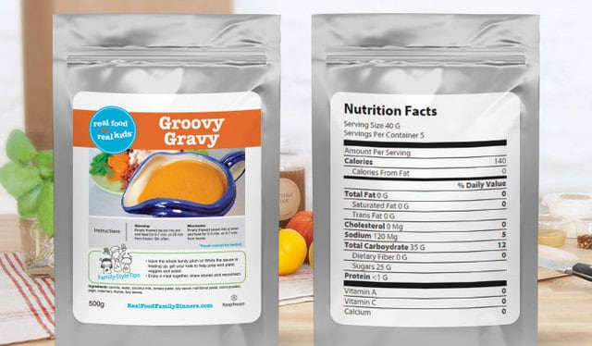
Contt.

Slide 76
Contt.
Many types of symbols for package labeling are nationally and internationally standardized. For consumer packaging, symbols exist for product certifications, trademarks, and proof of purchase. Some requirements and symbols exist to communicate aspects of consumer use and safety.
In some countries, many products, including food and pharmaceuticals, are required by law to contain certain labels such as ingredients, nutritional information, or usage warning information

Slide 77
Channel of Distribution
Distribution Channel:
The distribution function of marketing is comparable to the place component of the marketing mix in that both center on getting the goods from the producer to the consumer.
A distribution channel in marketing refers to the path or route through which goods and services travel to get from the place of production or manufacture to the final users. It has at its center transportation and logistical considerations.

Slide 78
Contt.
Business-to-business (B2B) distribution occurs between a producer and industrial users of raw materials needed for the manufacture of finished products.
For example, a logging company needs a distribution system to connect it with the lumber manufacturer who makes wood for buildings and furniture.

Slide 79
Contt.
Business-to-customer (B2C) distribution occurs between the producer and the final user.
For instance, the lumber manufacturer sells lumber to the furniture maker, who then makes the furniture and sells it to retail stores, who then sell it to the final customer.

Slide 80
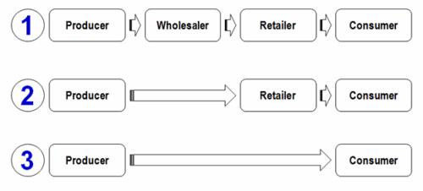
Contt.

Slide 81
Contt.
Direct vs. Indirect
Direct Distribution
A distribution system is said to be direct when the product or service leaves the producer and goes directly to the customer with no middlemen involved.
This occurs, more often than not, with the sale of services. For example, both the car wash and the barber utilize direct distribution because the customer receives the service directly from the producer.
This can also occur with organizations that sell tangible goods, such as the jewelry manufacturer who sells its products directly to the consumer

Slide 82
Contt.
Indirect Distribution
Indirect distribution occurs when there are middlemen or intermediaries within the distribution channel.
In the wood example, the intermediaries would be the lumber manufacturer, the furniture maker, and the retailer.
The larger the number of intermediaries within the channel, the higher the price is likely to be for the final customer. This is because of the value adding that occurs at each step within the structure.

Slide 83
Contt.
Types of Marketing Intermediaries In distribution channels:
Marketing intermediaries, also known as middlemen or distribution intermediaries, are an important part of the product distribution channel.
Intermediaries are individuals or businesses that make it possible for the product to make it from the manufacturer to the end user, essentially facilitating the sales process.
According to Business Dictionary, the four basic types of marketing intermediaries are agents, wholesalers, distributors and retailers.

Slide 84
Contt.
Agents
The agent as a marketing intermediary is an independent individual or company whose main function is to act as the primary selling arm of the producer and represent the producer to users.
Agents take possession of products but do not actually own them. Agents usually make profits from commissions or fees paid for the services they provide to the producer and users.

Slide 85
Contt.
Wholesalers
Wholesalers are independently owned firms that take title to the merchandise they handle. In other words, the wholesalers own the products they sell. Wholesalers purchase product in bulk and store it until they can resell it.
Wholesalers generally sell the products they have purchased to other intermediaries, usually retailers, for a profit.

Slide 86
Contt.
Distributors
Distributors are similar to wholesalers, but with one key difference. Wholesalers will carry a variety of competing products, for instance Pepsi and Coke products, whereas distributors only carry complementary product lines, either Pepsi or Coke products.
Distributors usually maintain close relationships with their suppliers and customers. Distributors will take title to products and store them until they are sold.

Slide 87
Contt.
Retailers
A retailer takes title to, or purchases, products from other market intermediaries.
Retailers can be independently owned and operated, like small “mom and pop” stores, or they can be part of a large chain, like Walmart.
The retailer will sell the products it has purchased directly to the end user for a profit.

Slide 88
SEGMENTATION
Meaning & Concept:
Market segmentation is the process of dividing a market of potential customers into groups, or segments, based on different characteristics.
The segments created are composed of consumers who will respond similarly to marketing strategies and who share traits such as similar interests, needs, or locations
Market segmentation is the process of dividing an entire market up into different customer segments.

Slide 89
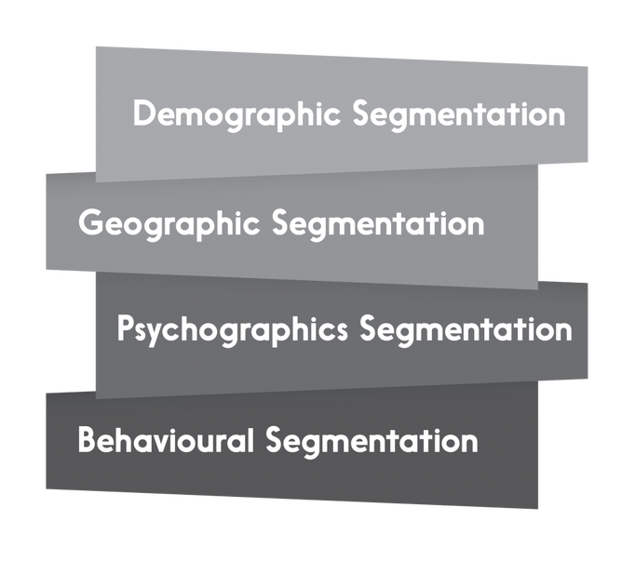
Types of Segmentation

Slide 90
Contt.
(Demographic Segmentation)
Gender: The marketers divide the market into smaller segments based on gender. Both men and women have different interests and preferences, and thus the need for segmentation.
Age Group: Division on the basis of age group
The products and marketing strategies for teenagers would obviously be different than kids.
Age group (0 - 10 years) - Toys, Nappies, Baby Food, Prams
Age Group (10 - 20 years) - Toys, Apparels, Books, School Bags
Age group (20 years and above) - Cosmetics, Anti-Ageing Products, Magazines, apparels and so on

Slide 91
Contt.
Income
Marketers divide the consumers into small segments as per their income. Individuals are classified into segments according to their monthly earnings.
The three categories are:
High income Group
Mid Income Group
Low Income Group

Slide 92
Contt.
Marital Status
Market segmentation can also be as per the marital status of the individuals. Travel agencies would not have similar holiday packages for bachelors and married couples.
Occupation
Office goers would have different needs as compared to school / college students.
A beach house shirt or a funky T Shirt would have no takers in a Zodiac Store as it caters specifically to the professionals.

Slide 93
Contt.
Behavioral Segmentation: The market is also segmented based on audience’s behaviour, usage, preference, choices and decision making.
The segments are usually divided based on their knowledge of the product and usage of the product.
The audience can be segmented into –
Those who know about the product,
Those who don’t know about the product,
Ex users,
Potential users,
Current Users,
First time users, etc.

Slide 94
Contt.
Psychographic Segmentation
Psychographic Segmentation divides the audience on the basis of their personality, lifestyle and attitude. This segmentation process works on a premise that consumer buying behaviour can be influenced by his personality and lifestyle
Personality and lifestyle influence the buying decision and habits of a person to a great extent. A person having a lavish lifestyle may consider having an air conditioner in every room as a need, whereas a person living in the same city but having a conservative lifestyle may consider it as a luxury.

Slide 95
Contt.
Geographic Segmentation
Geographic segmentation refers to the classification of market into various geographical areas. A marketer can’t have similar strategies for individuals living at different places.
Nestle promotes Nescafe all through the year in cold states of the country as compared to places which have well defined summer and winter season.
McDonald’s in India does not sell beef products as it is strictly against the religious beliefs of the countrymen, whereas McDonald’s in US freely sells and promotes beef products.

Slide 96
Contt
Advantages of Market Segmentation:
1. Segmenting a market gives focus to company as it helps to understand the market better
2. Unnecessary costs are avoided as only the required population can be tapped
3. Segmentation can help companies identify newer markets where existing products can be launched
4. Homogeneous groups can themselves promote the products or services even more if they like it
5. Systematic market segmentation helps in market expansion and also helps in customer retention

Slide 97
Contt.
Disadvantages of Market Segmentation:
1. A company having multiple segments would have to cater to them separately i.e. more costs
2. Giving products/ services to multiple segments can be a time-consuming process for companies
3. If a company selects a wrong segment, their entire business can collapse
4. Smaller clusters/ niche markets often get neglected in the bigger scheme of things

Slide 98
Process of Market segmentation
Steps in Market Segmentation:
Segmentation refers to the process of creating small segments within a broad market to select the right target market for various brands.
Market segmentation helps the marketers to devise and implement relevant strategies to promote their products amongst the target market.

Slide 99
Contt.
Identify the target market
The first and foremost step is to identify the target market. The marketers must be very clear about who all should be included in a common segment.
Make sure the individuals have something in common. A male and a female can’t be included in one segment as they have different needs and expectations.
Lower Income Group - Maruti 800, Alto
Middle Income Group - Wagon R, Swift, Swift Dzire, Ritz
High Income Group - Maruti Suzuki Kizashi, Suzuki Grand Vitara

Slide 100
Contt.
Identify expectations of Target Audience
Once the target market is decided, it is essential to find out the needs of the target audience.
The product must meet the expectations of the individuals.
The marketer must interact with the target audience to know more about their interests and demands.
Kellogg’s K special was launched specifically for the individuals who wanted to cut down on their calorie intake.

Slide 101
Contt.
Review the needs of the target audience
It is essential for the marketer to review the needs and preferences of individuals belonging to each segment and sub-segment. The consumers of a particular segment must respond to similar fluctuations in the market and similar marketing strategies.
Name your market Segment
Give an appropriate name to each segment. It makes implementation of strategies easier.
A kids section can have various segments namely new born, infants, toddlers and so on.

Slide 102
Contt.
Marketing Strategies: Devise relevant strategies to promote brands amongst each segment. Remember you can’t afford to have same strategies for all the segments. Make sure there is a connect between the product and the target audience..
A model promoting a sunscreen lotion has to be shown roaming or working in sun for the desired impact.
Review the behavior: Review the behavior of the target audience frequently. It is not necessary individuals would have the same requirement (demand) all through the year.
Size of the Target Market
It is essential to know the target market size. Collect necessary data for the same. It helps in sales planning and forecasting.

Slide 103
PRICING
Meaning of Pricing:
Price is the value that is put to a product or service and is the result of a complex set of calculations, research and understanding and risk taking ability.
A pricing strategy takes into account segments, ability to pay, market conditions, competitor actions, trade margins and input costs, amongst others.
It is targeted at the defined customers and against competitors

Slide 104
Pricing Objectives
The pricing objectives reflect overall goal of the organization. It describes the what an organization wants to achieve through pricing.
All the pricing policies and strategies are determined by the parameter of pricing objectives.
So, pricing objective provides the guideline-setting the pricing policies and strategies.
Moreover, the pricing objectives determine the overall objectives of the organization.

Slide 105
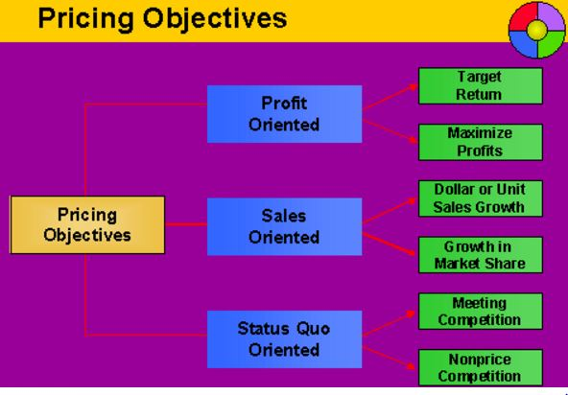
Contt.

Slide 106
Contt.
Profit Oriented Objectives
Profit oriented objectives focus on profit. This objective can be profit maximization and achieve target return.
To maximize profit:
One of the objectives of pricing is to maximize the profit. It is very important to maximize the profit to run the organization. Some company set price to their products or services with a view of maximizing profit
Achieving target return:
Another objective of pricing is to achieve target return. Some company may determine the price of their goods or services to achieve a certain return on investment or on sales

Slide 107
Contt.
Sales Oriented Objectives
Sales oriented pricing objectives focus on sales volume rather than on profit. The profit can be to gain sales volume and market share.
Sales volume increase:
One of the pricing objectives may be determined in terms of increasing sales volumes over the certain period of time. For example, 10% increase annually. This does not mean that profit should be avoided

Slide 108
Contt.
Maintain market share:
Pricing should have the basic objectives in maintaining market share. Market share is really a meaningful measure of the success of a firm's marketing strategy. A market share price objective can be either to maintain the market share, to increase it or sometimes to decrease it.
Meet competition:
The objective of pricing is to meet the competition in the market. Now there is big competition in the market. In highly competitive market some organization may set the meet

Slide 109
Pricing Strategies
These are different Pricing strategies used by different companies:
Skimming strategy: high price is charged for a product till such time as competitors allow after which prices can be dropped. The idea is to recover maximum money before the product or segment attracts more competitors who will lower profits for all concerned.
Penetration pricing: price is set artificially low to gain market share quickly. This is done when a new product is being launched.

Slide 110
Contt.
Premium pricing: high price is used as a defining criterion. Such pricing strategies work in segments and industries where a strong competitive advantage exists for the company. Example: Porche in cars and Gillette in blades
Psychological Pricing Strategies:
Psychological pricing Strategies is an approach of gathering the consumer’s emotional respond instead of his rational respond. For example a company will price its product at Rs 99 instead of Rs 100.

Slide 111
Contt.
Pricing Strategies of Product Line
Products line pricing is defined as pricing a single product or service and pricing a range of products.
Let us take and understand this with the help of an example. When you go for a car wash you have an option of choosing a car wash for RWF 200 or a car wash and a car wax for RWF 400
This strategy reflects a strategic cost of making a product popular and consumed by the consumer with a fair increment over the range of the product or the service.

Slide 112
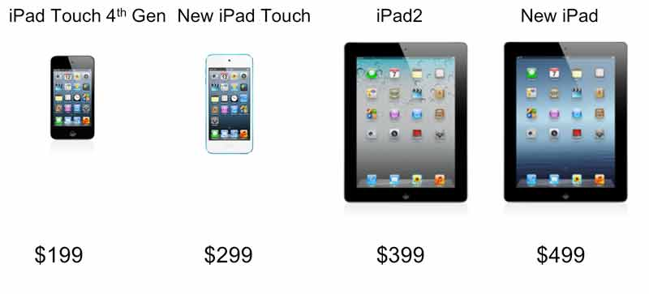
Example

Slide 113
Contt.
Pricing for promotions
Promotional pricing is very common these days. You will find it almost everywhere. Pricing for promoting a product is another very useful and helpful strategy. These promotion offers can include, discount offers, gift or money coupons or vouchers, buy one and get one free, etc. to promote new and even existing products companies do adopt such strategies where they roll out these offers to promote their products

Slide 114
Contt.
Pricing as Per Geographic Locations
For simple reasons such as the geographic location the companies do vary or change the price of the product. Why does location of the market affect the price of the product?
The reasons can be many well some are scarcity of the product or the raw material of the product, the shipping cost of the product, taxes differ in a few countries, difference in the currency rate for products, etc.

Slide 115
Contt.
Pricing of Premium Products
Well this strategy works just the other way round. Premium products are priced higher due to their unique branding approach.
A high price for premium products is an extensive competitive advantage to the manufacturer as the high price for these products assures them that they are safe in the market due to their relatively high price.
Premium pricing can be charged for products and services such as precious jewelry, precious stones, luxurious services, cruses, luxurious hotel rooms, business air travel, etc. The higher the cost the more will be the value of the product amongst that class of audience.

Slide 116
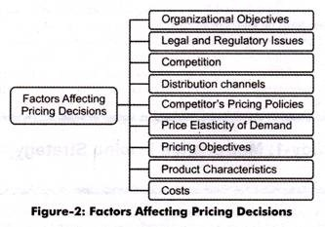
FACTORS INFLUENCING PRICING DECISIONS

Slide 117
Contt.
Organizational Objectives:
Affect the pricing decisions to a great extent. The marketers should set the prices as per the organizational goals. For instance, an organization has set a goal to produce quality products, thus, the prices will be set according to the quality of products
Costs: Influence the price setting decisions of an organization. The organization may sell products at prices less than that of the competitors even if it is incurring high costs. By following this strategy, the organization can increase sales volumes in the short run but cannot survive in the long run.

Slide 118
Contt.
Legal and Regulatory Issues:
Persuade marketers to change price decisions. The legal and regulatory laws set prices on various products, such as insurance and dairy items. These laws may lead to the fixing, freezing, or controlling of prices at minimum or maximum levels.
Product Characteristics:
Include the nature of the product, substitutes of the product, stage of life-cycle of the product, and product diversification

Slide 119
Contt.
Competition: Affects prices significantly. The organization matches the prices with the competitors and adjusts the prices more or less than the competitors. The organization also assesses that how the competitors respond to changes in the prices.
Pricing Objectives: Help an organization in determining price decisions. For instance, an organization has a pricing objective to increase the market share through low pricing. Therefore, it needs to set the prices less than the competitor prices to gain the market share.
Giving rebates and discounts on products is also a price objective that influences the customer’s decisions to buy a product.

Slide 120
Contt.
Price Elasticity of Demand:
Refers to change in demand of a product due to change in price.
There are three situations that arise under it:
Products that have inelastic demand will be highly priced
Products that have more than elastic demand will be priced low
Products that have elastic demand will be reasonably priced.

Slide 121

Contt.
Competitor’s pricing Policies:
Influence the pricing policies of the organizations. The price of a product should be determined in such a way that it should easily face price competition.

Slide 122
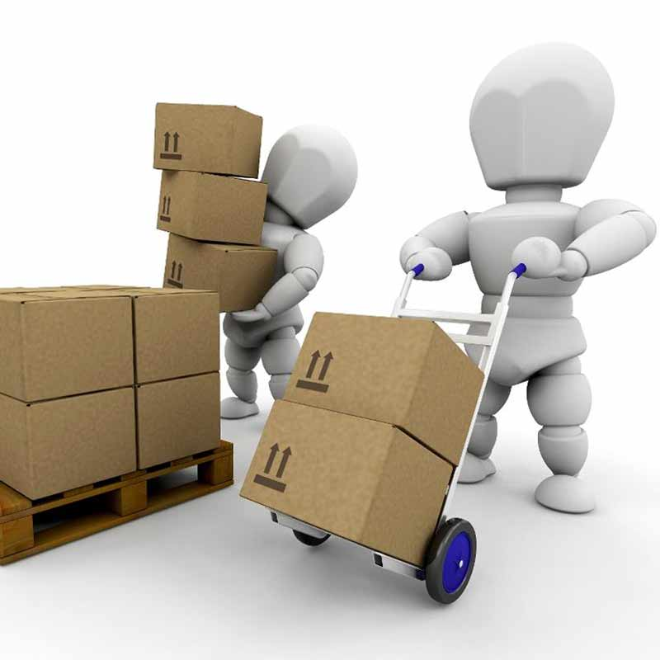
Contt.
Distribution Channels: Implies a pathway through which the final products of manufacturers reach the end users. If the distribution channel is large, price of the product will be high and if the distribution channel is short, the price of the product will be low.

Slide 123
Consumer Behaviour
Introduction : consumer behaviour is important for any organization before launching a product.
If the organization failed to analyze how a customer will respond to a particular product, the company will face losses.
Consumer behaviour is very complex because each consumer has different mind and attitude towards purchase, consumption and disposal of product
Understanding the theories and concepts of consumer behaviour helps to market the product or services successfully

Slide 124
Contt.
Consumer Behaviour or the Buyer Behaviour is referred to the behaviour that is displayed by the individual while they are buying, consuming or disposing any particular product or services.
These behaviours can be affected by multiple factors. Moreover, it also involves search for a product, evaluation of product where the consumer evaluate different features, purchase and consumption of product.
Later the post purchase behaviour of product is studied which shows the consumer satisfaction or dissatisfaction where it involves disposal of product

Slide 125
Contt.
Meaning and Important Concepts
Who is a Consumer ?
Any individual who purchases goods and services from the market for his/her end-use is called a consumer.
In simpler words a consumer is one who consumes goods and services available in the market.
Example - Tom might purchase a tricycle for his son or Mike might buy a shirt for himself. In the above examples, both Tom and Mike are consumers.

Slide 126
Contt.
What is consumer Interest ?
Every customer shows inclination towards particular products and services. Consumer interest is nothing but willingness of consumers to purchase products and services as per their taste, need and of course pocket.
What is Consumer Behaviour ?
Consumer Behaviour is a branch which deals with the various stages a consumer goes through before purchasing products or services for his end use.

Slide 127
Contt.
Why do you think an individual buys a product ?
Need
Social Status
Gifting Purpose
Why do you think an individual does not buy a product ?
No requirement
Income/Budget/Financial constraints
Taste

Slide 128
Contt.
When do you think consumers purchase products
Festive season
Birthday
Anniversary
Marriage or other special occasions
There are infact several factors which influence buying decision of a consumer ranging from psychological, social, economic and so on.

Slide 129
Contt.
The study of consumer behaviour explains as to:
Why and why not a consumer buys a product ?
When a consumer buys a product ?
How a consumer buys a product ?
According to Belch and Belch,
whenever need arises; a consumer searches for several information which would help him in his purchase
Following are the sources of information:
Personal Sources
Commercial Sources
Public Sources
Personal Experience

Slide 130
Contt.
Perception also plays an important role in influencing the buying decision of consumers.
Buying decisions of consumers also depend on the following factors:
Messages, advertisements, promotional materials, a consumer goes through also called selective exposure.
When customer interested in only what he wants to see. Such behaviour is called selective attention.
A consumer would certainly buy something which appeals him the most. He would remember the most relevant and meaningful message also called as selective retention. He would obviously not remember something which has nothing to do with his need.

Slide 131
Contt.
Importance of Consumer Behaviour to business managers:
To design the best possible product or service that fully satisfies consumer's needs and demands.
To decide where the service or product would be made available for easy access of consumers.
To decide the price at which the consumers would be ready to buy that product or service.
To find out the best method of promotion that will prove to be effective to attract customers to buy a product.
To understand why, when, how, what and other factors that influence buying decision of the consumers.

Slide 132
Contt.
Importance of Consumer Behaviour to Marketers:
To understand Buying Behaviour of consumers
To create and retain customers though online stores
To Understand the factors influencing Consumer's buying Behaviour
To understand the consumer's decision to dispose a product or services
To increase the knowledge of sales person influence consumer to buy product
To help marketers to sale of product and create focused marketing strategies

Slide 133
Consumer Decision Making process
Stages in Consumer Decision Making Process:
An individual who purchases products and services from the market for his/her own personal consumption is called as consumer.
To understand the complete process of consumer decision making, let us first go through the following example:
Tim went to a nearby retail store to buy a laptop for himself. The store manager showed him all the latest models and after few rounds of negotiations, Tim immediately selected one for himself.
In the above example Tim is the consumer and the laptop is the product which Tim wanted to purchase for his end-use.

Slide 134
Contt.
A consumer goes through several stages before purchasing a product or service.
NEED RECOGNITION
↓
INFORMATION GATHERING/SEARCH
↓
EVALUATION OF ALTERNATIVES
↓
PURCHASE OF PRODUCT/SERVICE
↓
POST PURCHASE EVALUATION?

Slide 135
Contt.
Step 1 - Need is the most important factor which leads to buying of products and services. Need infact is the catalyst which triggers the buying decision of individuals.
An individual who buys cold drink or a bottle of mineral water identifies his/her need as thirst
Step 2 - When an individual recognizes his need for a particular product/service he tries to gather as much information as he can. An individual can acquire information through any of the following sources:
Personal Sources , Commercial sources, Public sources , Experiential sources

Slide 136
Contt.
Step 3 - The next step is to evaluate the various alternatives available in the market. An individual after gathering relevant information tries to choose the best option available as per his need, taste and pocket.
Step 4 - After going through all the above stages, customer finally purchases the product.
Step 5 - The purchase of the product is followed by post purchase evaluation. Post purchase evaluation refers to a customer’s analysis whether the product was useful to him or not, whether the product fulfilled his need or not?

Slide 137
Factors affecting CB
Factors affecting Consumer Behaviour:
Social factors play an essential role in influencing the buying decisions of consumers.
Human beings are social animals. We need people around to talk to and discuss various issues to reach to better solutions and ideas.
Social Factors influencing consumer buying decision can be classified as under:
Reference Groups, Immediate Family Members
Relatives, Role in the Society
Status in the society

Slide 138
Contt.
Cultural Factors ?
Cultural factors comprise of set of values and ideologies of a particular community or group of individuals. It is the culture of an individual which decides the way he/she behaves.
In simpler words, culture is nothing but values of an individual. What an individual learns from his parents and relatives as a child becomes his culture

Slide 139
Contt.
Psychological Factors affecting Consumer Behaviour
Let us understand the effect of psychological factors on consumer behaviour i.e Motivation
Nancy went to a nearby restaurant and ordered pizza for herself.
Why did Nancy buy pizza ?
Answer - She was feeling hungry and wanted to eat something.
In the above example, Hunger was the motivating factor for Nancy to purchase pizza. There are several other factors which motivate individuals to purchase products and services.

Slide 140
Contt.
Personal Factors affecting Consumer Behaviour
Occupation
The occupation of an individual plays a significant role in influencing his/her buying decision. An individual’s nature of job has a direct influence on the products and brands he picks for himself/herself
Age and human lifecycle also influence the buying behaviour of consumers. Teenagers would be more interested in buying bright and loud colours as compared to a middle aged or elderly individual who would prefer decent and subtle designs.
A bachelor would prefer spending lavishly on items like beer, bikes, music, clothes, parties, clubs and so on.

Slide 141
Contt.
Economic Condition
The buying tendency of an individual is directly proportional to his income/earnings per month. How much an individual brings home decides how much he spends and on which products?
Personality
An individual’s personality also affects his buying behaviour. Every individual has his/her own characteristic personality traits which reflect in his/her buying behaviour.
A fitness freak would always look for fitness equipments whereas a music lover would happily spend on musical instruments, CDs, concerts, musical shows etc.

Slide 142
Needs Hierarchy Theory
Maslow’s Hierarchy of Needs:
Psychologist Abraham Maslow introduced the concept of a Hierarchy of Needs.
His hierarchy proposes that people are motivated to fulfill basic needs before moving on to meet higher level growth needs.
Maslow’s Hierarchy of Needs (often represented as a pyramid with five levels of needs) is a motivational theory in psychology that argues that while people aim to meet basic needs, they seek to meet successively higher needs in the form of a pyramid.

Slide 143
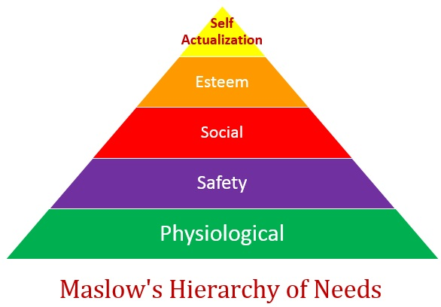
Contt.

Slide 144
Contt.
Physiological Needs
Physiological needs deal with the maintenance of the human body.
This lowest category includes the most basic needs that are vital to survival, such as the need for water, air, food, and sleep. Maslow believed that these needs are the most instinctive needs because all needs become secondary until these needs are met.
If we need water, then little else matters until we have something to drink.
Examples of physiological needs: air, food, water, shelter, warmth, sleep, etc.

Slide 145
Contt.
Safety and Security Needs
Safety and security needs are about keeping us safe from harm.
These needs include shelter, job security, health, and safe environments.
If a person does not feel safe in an environment, they will seek to find safety before they attempt to meet any higher level needs.
These security needs are important for survival, but they are not as important as the basic physiological needs.
Examples of safety and security needs: safety, shelter, security, law & order, employment, health, stability, etc.

Slide 146
Contt.
Social Needs
Social needs advance our tribal nature. These are the needs for belonging, love, affection as well as for relationships with family and friends and companionship.
These needs are met through pleasing and fulfilling relationships with others. A pleasing and fulfilling relationship would imply acceptance by others.
Having satisfied their basic physiological and security needs, people can seek relationships from which their need for love and belonging can be met.
Examples of social needs: Belongingness, love, affection, intimacy, family, friends, relationships, etc.

Slide 147
Contt.
Esteem Needs
After the more basic needs have been satisfied, esteem needs becomes important to an individual. Once an individual have satisfactorily met their need for love and belonging, they can begin to develop positive feelings of self-worth and self-esteem.
Esteem needs are for a higher position within a group and act to foster pride in their work and in themselves as individuals. These needs include self-esteem, respect, achievement, confidence, recognition, and accomplishment.
Examples esteem needs: self-esteem, self-confidence, achievement, recognition, status, respect, etc.

Slide 148
Contt.
Self-actualizing Needs
Self Actualization is the highest level of Maslow’s hierarchy. This level of need pertains to what a person’s full potential is and realizing that potential. “What a man can be, he must be” is the basis of the perceived need for self-actualization.
Maslow describes this as the desire to become everything that one is capable of becoming.
Examples of self-actualizing needs: realizing personal potential, self-fulfillment, pursue talent, personal growth, peak experiences, creativity, etc.

Slide 149
Promotional Mix
The Promotional Mix Concept:
Product promotion is critical for every business due to the lasting impact promotion has on the clients.
The promotion mix is essentially what promoting entails as well as how promoting is effectively done.
It comprises personal selling, advertising, public relations, sales promotion, and direct marketing.
Using the right blend of the promotional mix ensures that a business will continue gaining customers and achieving success in both the short and long run.

Slide 150
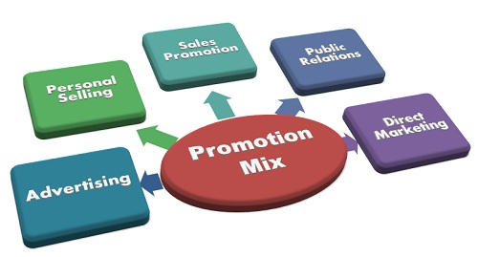
Contt.

Slide 151
Contt.
Personal Selling
This is usually the most costly tool but is one of the most effective tools in the promotional mix. It is effective since it builds a long-term relationship between the client and employee that will continue coming back.
Direct Marketing
Direct marketing uses technology to target clients individually. Examples include telephone calls, apps, e-mail, and catalogs. Direct marketing is useful since it targets individuals that spend small amounts of money at different times since they do not spend as much cash as frequently.

Slide 152
Contt.
Public relations
Every business needs public relations but many businesses often overlook it since they typically associate it with dealing with negative situations that can affect a company.
A good Public Relations manager for a business should be dynamic to handle both positive and negative situations.
On the positive side, a Public Relations campaign is implemented through newsletters, social media, press releases, grand openings, and major events. Social media is particularly a useful tool for public relations since the masses use it and love it.

Slide 153
Contt.
Sales Promotions
These provide a great way to get customers to buy a particular service or product.
Attraction factor
Sales promotions are particularly useful in the service industry since many people are not willing to pay full price for a vacation package.
However, once they get a promotion of 20% off they become attracted to the offer immediately. Restaurants can also make use of sales promotions to boost sales by bringing more people into the restaurant. Sales promotions work for other industries too. You can find stores offering 20% discounts on selected items and so on.

Slide 154
Contt.
Advertising
Advertising plays a key role when promoting a business. Newspapers, Radio, TV, and Social Media advertising all play an important role in determining how to target customers as well as how they will respond to the advertising message.
Social Media marketing
Social media is currently taking over from the traditional forms of advertising.

Slide 155
Factors Affecting Promotion Mix
Factors Affecting Promotion Mix
Definition:
The Promotion Mix is the blend of several promotional activities (Advertising, personal selling, sales promotion, public relations, direct marketing) used by business to create, maintain and increase the demand for a product.
The management must consider the following factors in determining the promotion mix, these are:

Slide 156
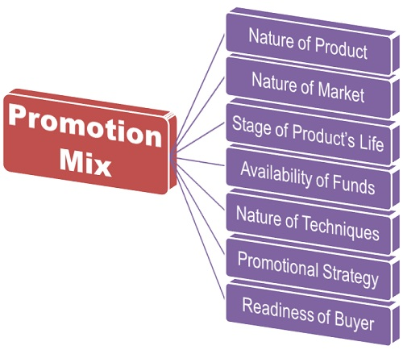
Contt.

Slide 157
Contt.
Nature of Product:
The different type of product requires different promotional tools. Such as, for the industrial products Viz. Machinery, equipment or land personal selling is more appropriate as a great deal of pre-sale and after-sale services is required to sell and install such products.
On the other hand, advertising and publicity are more suitable for the consumer goods, especially the convenience goods.

Slide 158
Contt.
Nature of Market: The number and location of customers greatly influence the promotion mix.
In case the group of potential customers is small and are concentrated in a particular locality, then personal selling is more likely to be effective.
Whereas, if the customer base is large and widespread, then the blend of advertising, personal selling, and the sales promotion is required to sell the product.

Slide 159
Contt.
Availability of Funds:
The marketing budget also decides the promotion mix. If the funds available for the promotion are large, then the blend of promotional tools can be used, whereas in the case the funds are limited then the management must choose the promotional tool wisely.
Promotional Strategy: In a Push strategy, the manufacturer forces the dealers to carry the product and promote it to the customer, i.e. convince the potential buyers to buy it. Here, personal selling and trade promotion are likely to be more effective.
In the case of a Pull Strategy, the consumers ask the dealers to carry the product, i.e. customers themselves purchase the product. Here, advertising and consumer promotion are more appropriate.

Slide 160
Contt.
Readiness of Buyer: Different promotional tools are required at different stages of buyer readiness. Such as, at the comprehension stage, the blend of advertising and personal selling plays a vital role.
Whereas at the conviction stage, personal selling is more effective. At the time of sales closure, the blend of sales promotion and personal selling is likely to be more effective.
Hence, the advertising and publicity are more effective at the early stages of buying decision process while the sales promotion and personal selling are more effective during the later stages

Slide 161
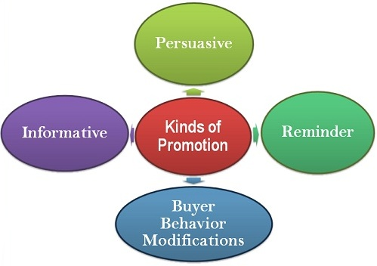
Different Kinds of Promotion
Kinds of Promotion: Definition: The Promotion is a mode of communication that companies use to create awareness among the prospective customers about the product, product line, brand and the company with an objective to generate sales and create a brand loyalty.

Slide 162
Contt.
Informative Promotion:
The primary objective of every promotional activity is to disseminate information about the product, product line, brand, and the company.
The informative promotion is prevalent at every stage of product life cycle and is an essential ingredient for creating the primary demand.
The marketers adopt this promotion strategy to convince customers to try a product at least once.
It is based on the notion that the customer will purchase the product only if he has the adequate information about it.

Slide 163
Contt.
Persuasive Promotion:
The persuasive promotion is prevalent at the growth stage of a product where the primary objective of the management is to persuade people to buy.
The basic purpose of this promotion strategy is to stimulate purchase and create a positive image of the product in the minds of customers in order to influence their long-term behaviors.
Many firms do not adopt this kind of promotion as it involves high-pressure selling

Slide 164
Contt.
Reminder Promotion:
The reminder promotion is often adopted at the stage when a product reaches its maturity.
The purpose of such promotion is to keep the product alive in the minds of the customers.
Here, the firm emphasizes on the product’s utility, features, brand names with the intent to make customers remind the product.
This promotion strategy acts as a “memory jogger” that enables the customers to remember the product and influences their long-term buying behavior.

Slide 165
Contt.
Buyer behavior Modifications:
The effect of promotional strategies could be accessed through the modifications in the consumer behavior. The constant personal selling and repeated advertisements could be used to measure the effectiveness of such promotional schemes.
Thus, the companies can choose any of the promotions depending on the nature of the product and the pursued objectives.

Slide 166
Marketing Communication
Meaning & Concept Marketing Communication
Definition: The Marketing Communication refers to the means adopted by the companies to convey messages about the products and the brands they sell, either directly or indirectly to the customers with the intention to persuade them to purchase.
In other words, the different medium that company adopts to exchange the information about their goods and services to the customers is termed as Marketing Communication.
The marketer uses the tools of marketing communication to create the brand awareness among the potential customers,

Slide 167
Contt.
Marketing communication offer solutions to the following questions:
Why shall the product be used?
How can the product be used?
Who can use the product?
Where can the product be used? And
When can the product be used?

Slide 168
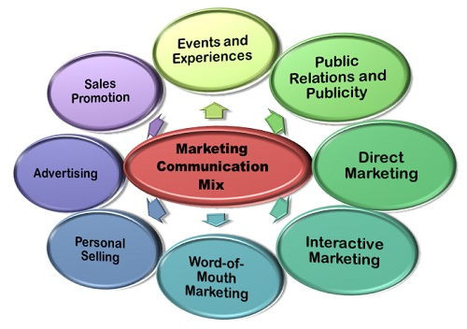
Elements of Marketing Communication .

Slide 169
Contt.
Advertising: It is an indirect, paid method used by the firms to inform the customers about their goods and services via television, radio, print media, online websites etcAdvertising is one of the most widely used methods of communication mix wherein the complete information about the firm’s product and services can be communicated easily with the huge target audience coverage.
Sales Promotion: The sales promotion includes the several short-term incentives to persuade the customers to initiate the purchase of the goods and services., discounts, paybacks, Buy- one –get- one free scheme, coupons, etc. are some of the sales promotion tools.

Slide 170
Contt.
Events and Experiences: Several companies sponsor the events such as sports, entertainment, nonprofit or community events with the intention to reinforce their brand in the minds of the customers and create a long term association with them.
The name of the firm sponsoring the event can be seen on the playground boundaries, player’s jerseys, trophies, awards in the entertainment shows, hoardings on stage, etc.
Public Relations and Publicity: The companies perform several social activities with a view to creating their positive brand image in the market. The activities that companies are undertaking such as, constructing the public conveniences, donating some portion of their purchase to the child education,

Slide 171
Contt.
Direct Marketing: With the intent of technology, the companies make use of emails, fax, mobile phones, to communicate directly with the prospective customers without involving any third party in between.
Interactive Marketing: Interactive Marketing has recently gained popularity as a marketing communication tool, wherein the customers can interact with the firms online and can get their queries resolved online.
Amazon is one of the best examples of interactive marketing

Slide 172
Contt.
Word-of- Mouth Marketing: It is one of the most widely practiced method of communication tool wherein customer share their experiences with their peers and friends about the goods and services they bought
Personal Selling: This is the traditional method of marketing communication wherein the salesmen approach the prospective customers directly and inform them about the goods and services they are dealing in. It is considered as one of the most reliable modes of communication because it is done directly either orally, i.e., face to face or in writing via emails or text messages.

Slide 173
Sales Promotions
Meaning of Sales Promotion:
The most important tool used in promotion is sales promotion. Most consumers relate ideas of marketing to the use of sales promotion techniques. The other main forms are advertising, and personal selling
The following section deals with sales promotion in detail.
Advertising takes the buyer towards the product, while sales promotion takes the product towards buyer.
The word ‘promotion’ is derived from the Latin word “Promovere“. This means to move forward or to push forward an idea. Sales promotion is the important element of promotion mix.

Slide 174
Contt.
Definition:
Those activities that supplement both personal selling and advertising, coordinate them and help to make them more effective”.
American Marketing Association
Sales promotion means any steps that are taken for the purpose of obtaining or increasing sales.
A.H.R. Delens

Slide 175
Contt.
Objectives of sales promotion
Sales promotion secures the following objectives
. Bridge between advertising and personal selling:
Introduction of new products
Attracting new customers:
. Inducing present customers to buy
Increasing sales during off season
. Encouraging business buyers
. Improving the public image of the firm

Slide 176
Process Of sales Promotion
Stages Involved in Sales Promotion Planning:
Establishment of objectives:
Sales-promotion objectives vary according to the target market. If the target is the customer, objectives could include the encouragement of increased usage or the building of trial among non-users or other brand users
. Selection of promotional tools:
Promotional objectives form the basis for selecting the most appropriate sales-promotion tools. The cost and effectiveness of each tool must be assessed with regard to achieving these objectives in respect of each target market.

Slide 177
Contt.
Planning the sales-promotion programme:
The major decisions that need to be made when designing the sales-promotion programme relate to the timing of the promotion and how long this tool is to be used. Also important are the size of incentive, rules for eligibility and, of course, the overall budget for the promotion
4. Pre-testing:
This needs to be undertaken to ensure that potentially expensive problems are discovered before the full launch of a promotion. Testing in selected market segments can highlight problems of ambiguity, response rates and give an indication of cost effectiveness.

Slide 178
Contt.
Implementation:
The programme for implementation must include two important time factors First, it must indicate the ‘lead time’- the time necessary to bring the programme up to the point where the incentive is made available to the public. Second, the ‘sell in time’ which is the period of time from the date of release to when approximately 90-95 per cent, of incentive material has been received by potential customers

Slide 179
Contt.
. Evaluation:
The performance of the promotion needs to be assessed against the objectives set. If objectives are specific and quantifiable, measurement would seem to be easy. However, extraneous factors could account for the apparent success of many sales-promotion activities.

Slide 180
Advertising
Advertising:
Advertising consists of all activities involved in presenting to a group a non-personal, oral or visual, openly sponsored identified message regarding a product, service, or idea. The message, called an advertisement, is disseminated through one or more media and is paid for by the identified sponsor”- William Stanton.
The world has become a global market.
Philip Kotler: “Advertising is any paid form of non-personal presentation and promotion of goods, services, or ideas by an identified sponsor.”
.

Slide 181

Contt.

Slide 182
Main Characteristics
Characteristics of Advertising:
Tool for Market Promotion:
There are various tools used for market communication, such as advertising, sales promotion, personal selling, and publicity. Advertising is a powerful, expensive, and popular element of promotion mix.
2. Non-personal:
Advertising is a type of non-personal or mass communication with the target audience. A large number of people are addressed at time. It is called as non-personal salesmanship.

Slide 183
Contt.
Paid Form:
Advertising is not free of costs. Advertiser, called as sponsor, has to spend money for preparing message, buying media, and monitoring advertising efforts. It is the costliest option of market promotion. Company has to prepare its advertising budget to appropriate advertising costs.
Wide Applicability:
Advertising is a popular and widely used means for communicating with the target market. It is not used only for business and profession, but is widely used by museums, charitable trusts, government agencies, educational institutions, and others to inform and attract various target publics.

Slide 184
Contt.
Varied Objectives:
Advertising is aimed at achieving various objectives. It is targeted to increase sales, create and improve brand image, face competition, build relations with publics, or to educate people.
Forms of Advertising:
Advertising message can be expressed in written, oral, audible, or visual forms. Mostly, message is expressed in a joint form, such as oral-visual, audio-visual, etc.

Slide 185
Contt.
Use of Media:
Advertiser can use any of the several advertising media to convey the message. Widely used media are print media (newspapers, magazines, pamphlets, booklets, letters, etc.), outdoor media (hoardings, sign boards, wall-printing, vehicle, banners, etc.), audio-visual media (radio, television, film, Internet, etc.), or any other to address the target audience.
8. Advertising as an Art:
Today’s advertising task is much complicated. Message creation and presentation require a good deal of knowledge, creativity, skills, and experience. So, advertising can be said as an art. It is an artful activity.

Slide 186
Contt
Element of Truth: It is difficult to say that advertising message always reveals the truth. In many cases, exaggerated facts are advertised. However, due to certain legal provisions, the element of truth can be fairly assured. But, there is no guarantee that the claim made in advertisement is completely true. Most advertisements are erotic, materialistic, misleading, and producer-centered.
One-way Communication: Advertising involves the one-way communication. Message moves from company to customers, from sponsor to audience. Message from consumers to marketer is not possible. Marketer cannot know how far the advertisement has influenced the audience.

Slide 187
Contt.
Key Decisions in Advertising:
Some experts explain advertising decisions and activities in form of six ‘M’s as under:
The first ‘M’ stands for Mission – Advertising Objectives.
The second ‘M stands for Money – Advertising Budget.
The third ‘M’ stands for Message – Creating Advertising Message and Copy.
The forth ‘M’ stand for Monitoring – Managing (organising) of Advertising Efforts.
The fifth ‘M’ stands for Media – Advertising Media Selection and Media Scheduling.
The sixth ‘M’ stands for Measurement – Measuring and Evaluating Advertising Effectiveness

Slide 188
Contt.
Advertising Objectives:
Prof. Sew and Prof. Smith have classified objectives as:
Sales objectives
Aiding sales force
Competition-related objectives
Brand loyalty and reputation-related objectives
To Help or Educate People
To Build and Improve Brand Image
To Achieve Sales Targets

Slide 189
Publicity
Meaning and Concept of Publicity:
Publicity is also a way of mass communication. It is not a paid form of mass communication that involves getting favourable response of buyers by placing commercially significant news in mass media. Publicity is not paid for by the organisation.
Publicity comes from reporters, columnists, and journalists. It can be considered as a part of public relations.

Slide 190
Contt.
William J. Stanton:
“Publicity is any promotional communication regarding an organisation and/or its products where the message is not paid for by the organisation benefiting from it.”
2. Philip Kotler:
Non-personal stimulation of demand for the product or service, or business unit by placing commercially significant news about it in public medium or obtaining favourable presentation of it upon radio, television, or stage that is not paid for by the sponsor.”

Slide 191
Contt.
Characteristics of Publicity:
Key characteristics of publicity have been briefly described in following part
Meaning:
Publicity is not a paid form of mass communication that involves getting favourable response of buyers by placing commercially significant news in mass media. It involves obtaining favourable presentation upon radio, newspapers, television, or stage that is not paid for by the sponsor

Slide 192
Contt.
Non-paid Form:
Publicity is not a paid form of communication. It is not directly paid by producer. However, it involves various indirect costs. For example, a firm needs some amount for arranging function, calling press conference, inviting outstanding personalities, decorating of stage, other related costs, etc.
Various Media:
Mostly, publicity can be carried via newspapers, magazines, radio, or television. For example, in case a product is launched by popular personality in a grand function, the mass media like newspapers, television, radio, magazines, etc., will definitely publicize the event.

Slide 193
Contt.
Importance of publicity can be made clear from the below stated points:
1. Publicity is an effective medium to disseminate message to the mass with more credibility. People have more trust on news given by publicity.
2. The credibility level of publicity is much higher than advertising and other means of market promotion. People express more trust on what the third party independently says. It appears directly through newspapers, magazines, television, or radio by the third party. It is free from bias.

Slide 194
Contt.
3. It provides more information as the valuable information is free from space and time constraints. Similarly, publicity takes place immediately. No need to wait for time or space in mass media. It enjoys priority.
4. The firm is not required to pay for publicity. The indirect costs related to publicity are much lower than other means of promotion.
5. It is a part of public relations. It is free from exaggeration; it carries more factual information about company. It is more trustable. It helps establish public relations.

Slide 195
Contt.
6. Generally, publicity covers the varied information. It normally involves name of company, its goods and services, history, outstanding achievements, and other similar issues. The knowledge is more complete compared to advertisement.
7. Publicity directly helps middlemen and sale persons. Their tasks become easy. Publicity speaks a lot about products on behalf of middlemen and salesmen. Sellers are not required to provide more information to convince the buyers.
8. It is suitable to those companies which cannot effort the expensive ways to promote the product.

Slide 196
Contt.
9. Publicity increases credit or fame of the company. Publicity on company’s assistance in relief operations during flood, earthquake, draught, and other natural calamities highlights its name and social contribution in mass media. People hold high esteem to this company.
10. Publicity can be used by non-commercial organisations/institutes like universities, hospitals, associations of blinds or handicaps, and other social and missionary organisations. They can publicize their noble works by the medium of publicity.

Slide 197
Contt.
Objectives of Publicity:
1. Building Corporate Image:
Through publicity, a company can build or improve its corporate image. People trust more on what press reporters, columnists, or newsreaders say via mass media independently than what the company says. Publicity highlights the company’s name and operations. It popularizes the name of the company.
. Economy:
It is a cost saving medium. Here, a company is not required to pay for message preparation, buying space and time, etc. The cost involved is much lower than other means of market promotion. Financially poor companies may opt for publicity.

Slide 198
Contt.
. Information with High Creditability:
Sometimes, publicity is targeted to disseminate information more reliably. Customers do not express doubts on what publicity appeals. Customers assign more value to information supplied by mass media via publicity than by the advertisement.
Removing Misunderstanding or Bad Image:
Company can defend the product that has encountered public problems. In many cases, publicity is aimed at removing misunderstanding or bad impression. Whatever a publicity conveys is more likely to be believed.

Slide 199
Contt.
Six Core Benefits of Publicity
Publicity can be hard to secure but if you can publicity brings along with it several benefits including -
Publicity is the low-cost or no-cost option.
Publicity positions your business and the principals of those businesses as experts in your industry.
Publicity helps your business to stand out and be noticed.
Publicity can help in the development of partnerships and strategic alliances.
Publicity builds your credibility and propels you into a competitive position

